Slide 1
PREDICTING BITTER PEPTIDES FROM SEQUENCE USING MACHINE LEARNING TECHNIQUES
Thesis Defense Presentation
by
Nishitha Yendapally
Date: 07-26-2022
Time: 11:00am

Slide 2

Outline
Introduction
Methodology
Framework
Model Description
Results
Conclusion

Slide 3
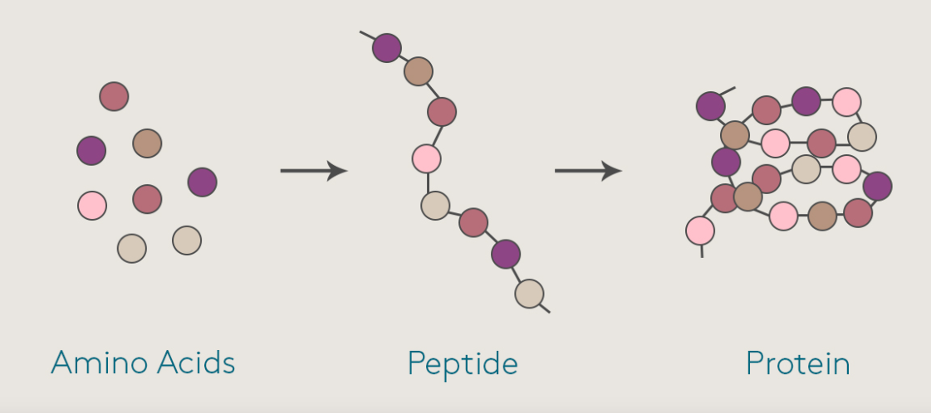
Introduction
What are peptides?
The peptides are the strings of amino acids typically comprising 2–50 amino acids.
They are smaller versions of proteins.

Slide 4
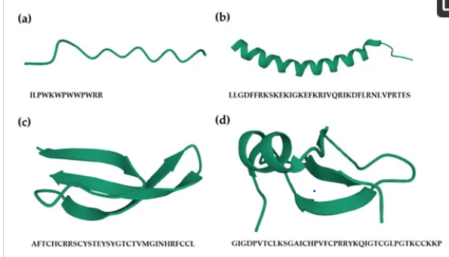
Introduction
3D view of peptide sequence:
(a) Linear peptide
(b) α-helical peptide
(c) β-sheeted peptide
(d) peptide including both α-helix and β-sheet
Amino acid chain with fewer than 20 are called as oligopeptides include dipeptides, tripeptides and tetrapeptides .

Slide 5

Introduction
Confusion?
Most People may confuse peptides with proteins.
Both proteins and peptides are made up of amino acids, but peptides contain far fewer amino acids than proteins. Like proteins, peptides are naturally present in foods.
Peptides may be easier for the body to absorb than proteins because they are smaller and more broken down than proteins.

Slide 6
Introduction
Uses of Peptides?
Peptides are useful in the development of drugs to combat critical diseases.
These drugs have a bitter taste by nature.
Thus, it is important to reduce the bitterness of these medicines to enhance taste and, as a result, increase drug compliance.

Slide 7
Introduction
Identifying bitter peptides are tedious, expensive, and time-consuming and it plays a vital role in nutritional studies.
Differentiating bitter from non-bitter peptides quickly and accurately is important using computational algorithms, given that in the post-genomic age, the volume of peptides produced.
The main purpose of this research is prediction of bitter peptides from the peptide sequence.
The identification and characterization of bitter peptides is crucial for the medical development.

Slide 8
Literature Review
Identifying bitterness in peptides is time consuming. In post genomic age the peptides are identified manually which takes lot of effort.
Literature presents several remarkable researches on the identifying the bitter peptides.
Several authors have used machine learning and statistical models for identifying the peptides bitterness.

Slide 9
Literature Review
iBitter-SCM is one method for the prediction of bitterness in peptides.
It uses the scoring card approach with propensity ratings for 20-amino acids and 400-dipeptides to differentiate bitterness and non-bitterness of the peptides.
Independent testing and 10 cross validation methods are used to examine five machine learning classifiers: K-Nearest Neighbour (KNN), Random Forest (RF), Nave Bayes (NB), Support Vector Machine (SVM), and Decision Tree (DT).
The other method is BERT4Bitter which uses the bidirectional encoder representation from transformer for prediction of peptides.

Slide 10

Novelty of The Proposed Research
This research proposes to explore various machine learning techniques specifically, stacking-based approaches for an effective prediction of bitter peptides directly from the peptide sequence.
In addition, this work we explore K-mers extraction techniques to extract 2-mers. Then these 2-mers are passed to TFIDF and count vectorizer for the feature extraction.
Experiments are performed to compare the models trained on TFIDF and count vectorizer feature extraction techniques to identify which extraction technique yields better performance.

Slide 11

Methodology - Datasets
Benchmark dataset:
In this research, we use BTP640 dataset that was previously established by Charoenkwan et al work.

Slide 12
Datasets
BTP640 dataset contains of 320-bitter and 320 non-bitter non redundant peptides.
BTP640 dataset was randomly divided into a training subset (named BTP-CV) and an independent test subset (called BTP-TS) with 0.8:0.2(80:20) of split ratio.
BTP-CV dataset contains 256 bitter and 256 non-bitter peptides that are utilized for validation and training.
BTP-TS contains 64 bitter peptides and 64 non-bitter peptides that are utilized for independent testing.

Slide 13
Number of Bitter and Non-Bitter peptides
Dataset | Total Number of peptides | BitterPeptides | Non-Bitter Peptides
Benchmark Dataset | 640 | 320 | 320
Training Dataset (BTP-CV) | 512 | 256 | 256
Testing Dataset (BTP-TS) | 128 | 64 | 64

Slide 14
FEATURE REPRESENTATION
The following can be used to represent a peptide sequence (P):
P= p₁ p₂ p₃…p_{N} (1)
Where p_{i} and N stand for the protein P’s, i^{th} residue and the length of the peptide, respectively.
The residue p_{i} is a member of the natural amino acid group, which also consists of the following amino acids: A, C, D, E, F, G, H, I, K, L, M, N, P, Q, R, S, T, V, W, and Y

Slide 15
FEATURE REPRESENTATION
In this research, various feature extraction techniques are utilized for accurate prediction of bitter peptides from the peptide sequences.
NLP techniques like TFIDF and count vectorization using K-mers counting are utilized for analyzing the sequences of data. The features extracted from the dataset is 316 and the value of k=2 for K-mer counting.

Slide 16
Feature Extraction: K-mers
Feature extraction is the most crucial step in transforming the raw data into the numerical values.
In this process of Feature extraction, K-mers extraction techniques is the very important to extract the 2-mers from the peptide sequence.
K-mers extraction Technique: In this technique the sequence is broken into the set of fixed-size chunks known as k-mers.

Slide 17
Feature Extraction- NLP
Once the 2-mers are extracted from the sequence. Then these 2-mers are passed to TFIDF and count vectorizer for the feature extraction.
TERM FREQUENCY-INVERSE DOCUMENT FREQUENCY (TFIDF):
Term Frequency-inverse document frequency, or TF-IDF, is a statistical metric that assesses how relevant a word is to a document within a collection of documents.
This is a popular method for document representation in NLP that is based on information retrieval techniques.

Slide 18
TFIDF is split into two parts term-frequency and inverse document frequency.
TF (Term Frequency) indicates the number of times a word i (t_{i}) appears in a particular document j (d_{j}), and IDF(Inverse Document Frequency) denotes the inverse document frequency for the target word.
The TF-IDF of a term is calculated by multiplying TF and IDF scores.
TF-IDF=TF∗IDF
Number of features extracted is 316.

Slide 19
Feature Extraction
316
Count Vectorizer:
In this research we also used Count vectorizer to compare with the TFIDF.
In general, Count Vectorizer is used to convert a peptide sequence to a vector of term/token counts.

Slide 20
Feature Selection
Then we used a feature selection technique to extract relevant features to train our model.
The feature selection technique utilized in this model is f_regression.
f_regression: f_regression is derived from r_regression and will rank features in the same order if all the features are positively correlated with the target.
f_regression is therefore recommended as a feature selection criterion to identify potentially predictive feature for a downstream classifier, irrespective of the sign of the association with the target variable.

Slide 21
Framework
Stacking-based model is utilized to develop a predictor of Bitter peptide from the peptide sequences.
This model can help to increase the efficiency, as the information from one or more models are combined to train a new model.

Slide 22
This thesis implements a 2-layer stacking framework that includes
Base-Layer and
Meta-Layer.
The first stage for this model is the Base-Layer, may contain several machine learning models.
The models in the Base-Layer are selected because the underlying operating principle is different so that they can pass valuable information to the Meta-Layer.
The models in the Base-Layer are trained to generate prediction probabilities for each amino acid, which are consequently appended to the original input features of the amino acid and passed on to the Meta-Layer for improved training.
The Meta-Layer produces the final predictions.

Slide 23
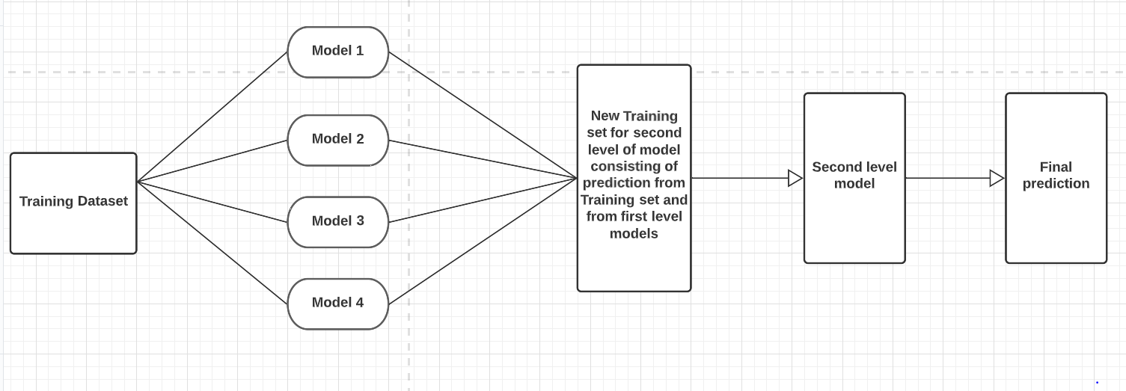
Architecture of a stacking-based model

Slide 24
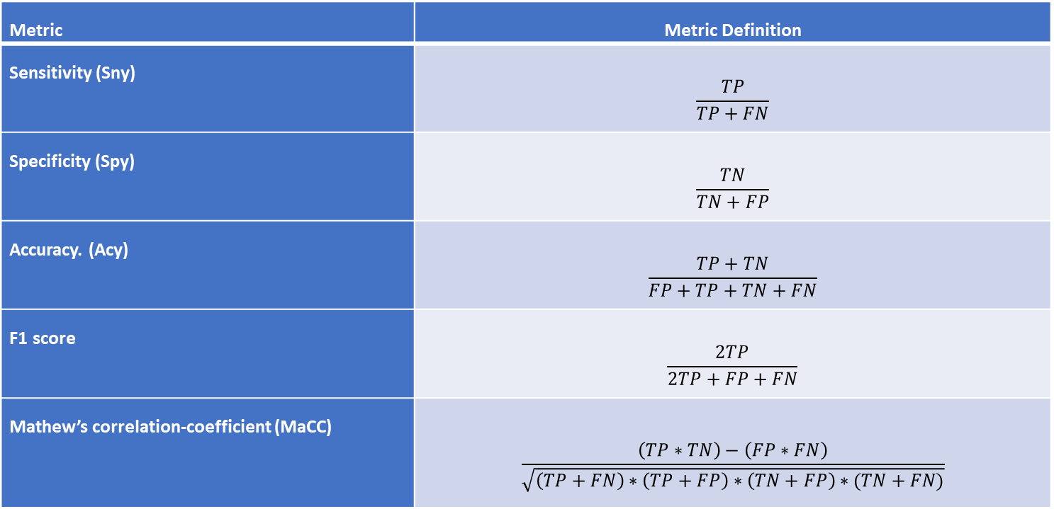
Performance Assessment Metrics
Metric | Metric Definition
Sensitivity (Sny) | $$\frac{TP}{TP+FN}$$
Specificity (Spy) | $$\frac{TN}{TN+FP}$$
Accuracy. (Acy) | $$\frac{TP+TN}{FP+TP+TN+FN}$$
F1 score | $$\frac{2TP}{2TP+FP+FN}$$
Mathew’s correlation-coefficient (MaCC) | $$\frac{\left(TP∗TN\right)−\left(FP∗FN\right)}{\sqrt{\left(TP+FN\right)∗\left(TP+FP\right)∗\left(TN+FP\right)∗(TN+FN)}}$$

Slide 25

Model description
Stacking-based framework is utilized for the classification of bitter peptides from the peptide sequence.
First, the BTP640 dataset are collected
The benchmark dataset consists of 640 peptide sequences containing both the bitter and Non-bitter peptides.
On the peptide sequences K-mers extraction techniques are used to extract 2-mers then followed by next steps.

Slide 26
Model description
Feature Extraction is performed on the sequence of 2-mers, here we use NLP.
TFIDF and count vectorizer for extraction of features available in the dataset.
Extracted Feature set 640x316 is utilized as an input to the machine learning(ML) algorithms and Stacking-based ensemble architecture is utilized after the appropriate transformation of the feature vector into the feature matrix.

Slide 27
Model description
Stacking based architecture employs three machine learning algorithms as the Base-Layer and the Random forest as the Meta-Layer classifier.
After that, the trained architecture is evaluated using 10-fold cross validation and Independent Testing.
Model's performance is evaluated based on the accuracy, sensitivity, specificity and MCC scores.

Slide 28
Model description
In this research, a 10-fold Cross Validation is utilized for comparing the outcomes of the suggested approach with the other Machine learning approaches.
First, the data is divided into ten equal sized folds, where 9-folds are utilized to train, and the remaining fold is utilized to test the method.
This procedure continues until each fold is tested at least once.

Slide 29
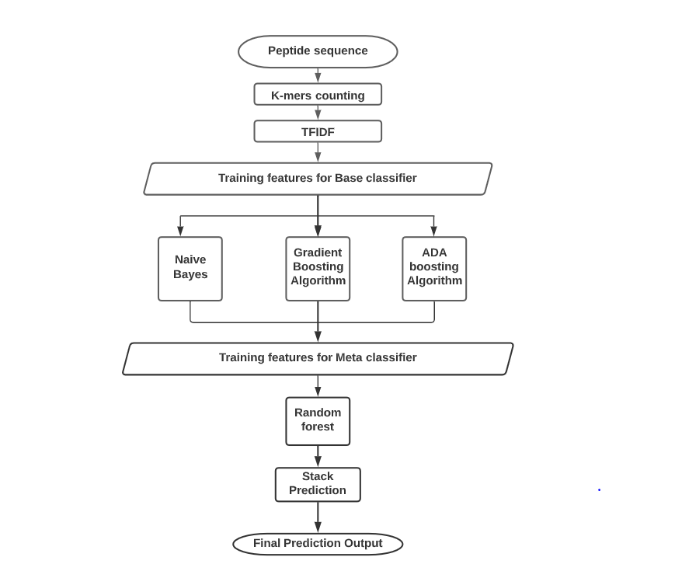
Stacking-Based Model:

Slide 30
Stacking-Based Model
The algorithms used in the Base-Layer are Gaussian Naïve Bayes, Gradient-Boosting Algorithm and ADA-Boosting Algorithm.
Gaussian Naïve Bayes is utilized in this model for better prediction of peptides.
Gaussian Naive Bayes : Machine learning algorithm used for many classification functions and is based on the Bayes theorem. Gaussian Naïve Bayes is the extension of naïve Bayes.
Gradient Boosting Algorithm and ADA-Boosting algorithm are the other two main powerful algorithms used in this model in the Base-Layer.

Slide 31
Stacking-Based Model
Gradient Boosting Algorithm: Gradient boosting algorithm can be used for predicting not only continuous target variable but also categorical target variable.
ADA Boosting Algorithm: Adaptive Boosting is one of ensemble boosting classifier. It combines multiple classifiers to increase the accuracy of classifiers.
As a meta layer Random Forest is used in which combines various decision trees into a forest or final model of decision trees that ultimately provides more accurate and consistent predictions.

Slide 32
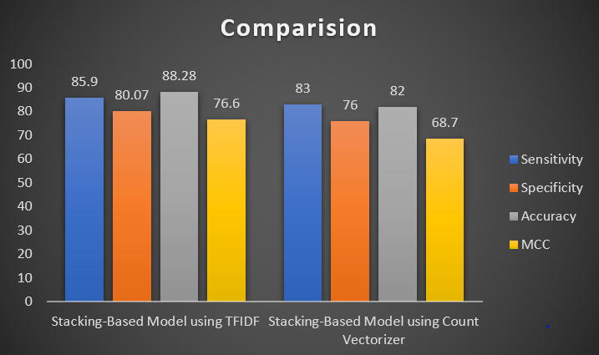
Results from different experiments:
Comparisons of scores between feature extraction techniques TFIDF and Count Vectorizer.

Slide 33
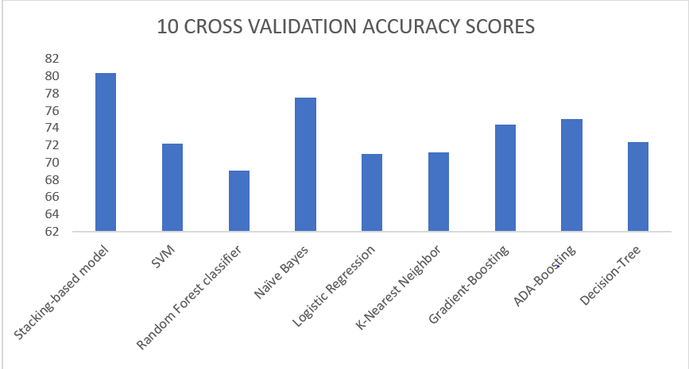
Results
Benchmark Dataset | S_{ny} % | S_{py} % | A_{cy}% | B_{acy} % | MaCC %
Stacking-based model | 78.5 | 85.0 | 80.4 | 80.4 | 60.5
SVM | 62.8 | 81.6 | 72.2 | 72.0 | 45.3
Random Forest classifier | 89.8 | 48.4 | 69.1 | 69.1 | 42.0
Naïve Bayes | 78.1 | 76.9 | 77.5 | 77.6 | 55.0
Logistic Regression | 67.2 | 75 | 71 | 71.0 | 42.3
K-Nearest Neighbor | 60.1 | 82.4 | 71.2 | 71.2 | 43.6
Gradient-Boosting | 83.5 | 65.2 | 74.4 | 74 | 49.6
ADA-Boosting | 64.8 | 85.0 | 75 | 75 | 51.0
Decision-Tree | 66.7 | 78.1 | 72.4 | 72.4 | 45.2

Slide 34
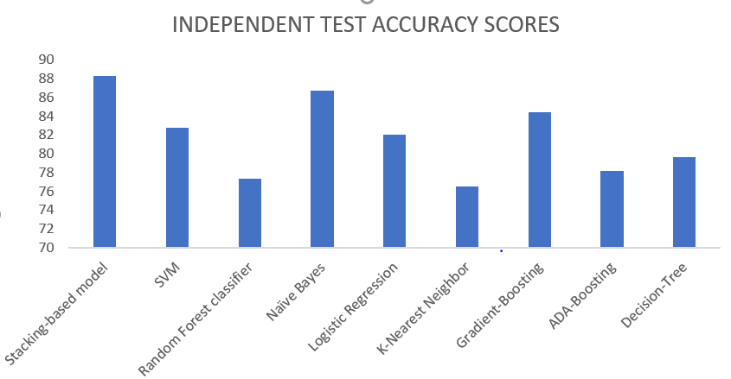
Results
Independent Test Dataset | S_{en} % | S_{py} % | A_{cy} % | B_{acy} % | MCC %
Stacking-based model | 85.9 | 80.0 | 88.2 | 79.6 | 76.6
SVM | 89.0 | 81.6 | 82.8 | 72.2 | 66.1
Random Forest classifier | 93.7 | 48.4 | 77.3 | 69.1 | 57.8
Naïve Bayes | 89.0 | 76.9 | 86.7 | 77.5 | 73.5
Logistic Regression | 92.1 | 75.0 | 82.0 | 71.0 | 65.4
K-Nearest Neighbor | 78.1 | 82.4 | 76.5 | 71.2 | 53.1
Gradient-Boosting | 95.3 | 68.3 | 84.3 | 74.2 | 70.4
ADA-Boosting | 68.7 | 85.1 | 78.1 | 75.0 | 57.2
Decision-Tree | 71.8 | 78.1 | 79.6 | 72.5 | 60.1

Slide 35
Results
After analyzing all the scores our model outperforms compare with the other machine learning algorithms and with the iBitter-SCM.
The proposed model performs 4.62% more accuracy score and 7% more MCC score compared with the iBitter-SCM which applies training using 10-fold cross validation and testing on the model
Independent Dataset | S_{ens} % | S_{pec} % | A_{ccu} % | B_{acc} % | MCC %
The Proposed Method | 85.9 | 80.07 | 88.28 | 79.68 | 76.6
iBitter-SCM | 84.38 | 84.38 | 84.38 | 0.904 | 68.88

Slide 36
Conclusion
In this research, we have applied a novel feature extraction technique called K-mers counting in combination of NLP technique TFIDF and stacking-based algorithm for the prediction of bitter peptides from peptide sequence.
From our result there was a great improvement in the accuracy and the MCC scores of the prediction of bitter peptides by 4.62% and 7.8% in the proposed method.

Slide 37
Conclusion
This research work would serve as a reference point in the field of bioinformatics.
The proposed model outperforms the iBitterSCM method and other Machine-learning methods. Hence this research has the potential to aid in the identification of significant bitter peptides.
Which contributes to the creation of novel medications.

Slide 38
References
Dagan-Wiener,A. et al. (2017) Bitter or not? BitterPredict, a tool for predicting taste from chemical structure. Sci. Rep., 7, 1–13.
Huang,W. et al. (2016) BitterX: a tool for understanding bitter taste in humans. Sci. Rep., 6, 23450.
Pripp,A. and Ardo,Y. (2007) Modelling relationship between angiotensin-(I)-converting enzyme inhibition and the bitter taste of peptides. Food Chem., 102, 880–888.
Zheng, Suqing, et al. "e-Bitter: bitterant prediction by the consensus voting from the machine-learning methods." Frontiers in chemistry 6 (2018): 82.
Phasit Charoenkwan, Janchai Yana, Nalini Schaduangrat, Chanin Nantasenamat, Md. Mehedi Hasan, Watshara Shoombuatong, iBitter-SCM: Identification and characterization of bitter peptides using a scoring card method with propensity scores of dipeptides Genomics,Volume 112, Issue 4,2020,Pages 2813-2822,ISSN 0888-7543,
Arroyo-Ferna´ndez,I. et al. (2019) Unsupervised sentence representations as word information series: revisiting TF–IDF. Comput. Speech Language, 56,107–129.

Slide 39
References
Charoenkwan,P. et al. (2020a) iAMY-SCM: improved prediction and analysis of amyloid proteins using a scoring card method with propensity scores of dipeptides. Genomics, 112, 2813–2822.
Charoenkwan,P. et al. (2020b) iDPPIV-SCM: a sequence-based predictor for identifying and analyzing dipeptidyl peptidase IV (DPP-IV) inhibitory peptides using a scoring card method. J. Proteome Res., 19, 4125–4136.
Charoenkwan,P. et al. (2020c) iUmami-SCM: a novel sequence-based predictor for prediction and analysis of umami peptides using a scoring card method with propensity scores of dipeptides. J. Chem. Inf. Model., 60,6666–6678
Charoenkwan,P. et al. (2020d) iBitter-SCM: identification and characterization of bitter peptides using a scoring card method with propensity scores of dipeptides. Genomics, 112, 2813-2822
Wei,L. et al. (2020) Computational prediction and interpretation of cell-specific replication origin sites from multiple eukaryotes by exploiting stacking framework. Brief. Bioinform., 2020, bbaa275
A. Aizawa, “An information-theoretic perspective of tf–idf measures.,” Information Processing & Management, pp. 45-65, 2003.
Chen,K. et al. (2016) Turning from TF-IDF to TF-IGM for term weighting in text classification. Expert Syst. Appl., 66, 245–260.

Slide 40
References
Mikolov,T. et al. (2013) Efficient estimation of word representations in vector space. arXiv preprint arXiv:1301.3781.
Tahir,M. et al. (2020) Prediction of N6-methyladenosine sites using convolution neural network model based on distributed feature representations. Neural Netw., 129, 385–391.
Wu,C. et al. (2019) PTPD: predicting therapeutic peptides by deep learning and word2vec. BMC Bioinformatics, 20, 1–8
Arroyo-Ferna´ndez,I. et al. (2019) Unsupervised sentence representations as word information series: revisiting TF–IDF. Comput. Speech Language, 56,107–129
Asgari,E. and Mofrad,M.R. (2015) Continuous distributed representation of biological sequences for deep proteomics and genomics. PLoS One, 10,e0141287.
Habibi,M. et al. (2017) Deep learning with word embeddings improves biomedical named entity recognition. Bioinformatics, 33, i37–i48.

Slide 41


Slide 42


